Slide 1
Chapter 17
How to design a website

Slide 2
Objectives
Applied
Design a website using the guidelines, methods, and procedures of this chapter.
Knowledge
Describe the notion of usability and explain how the current website conventions contribute to usability.
Describe two basic approaches that you can use to design the pages for Responsive Web Design.
Describe the primary principle for home-page design if you’re designing a small site for a relatively unknown company.
Describe three ways to let the users of a website know where they are.
Describe the use of chunking.
List three guidelines for typography on a web page.

Slide 3
Objectives (continued)
List three guidelines for web writing.
Describe the lifecycle of a website.
Describe the most important principle for making a website easier to maintain.
List the four steps in a general procedure for designing a website.
Describe the use of a site map for designing a website.
Describe the use of wireframes for designing web pages.
Distinguish between a web designer and a graphics designer.
Describe the concepts that top-down design and prototyping are based upon.

Slide 4
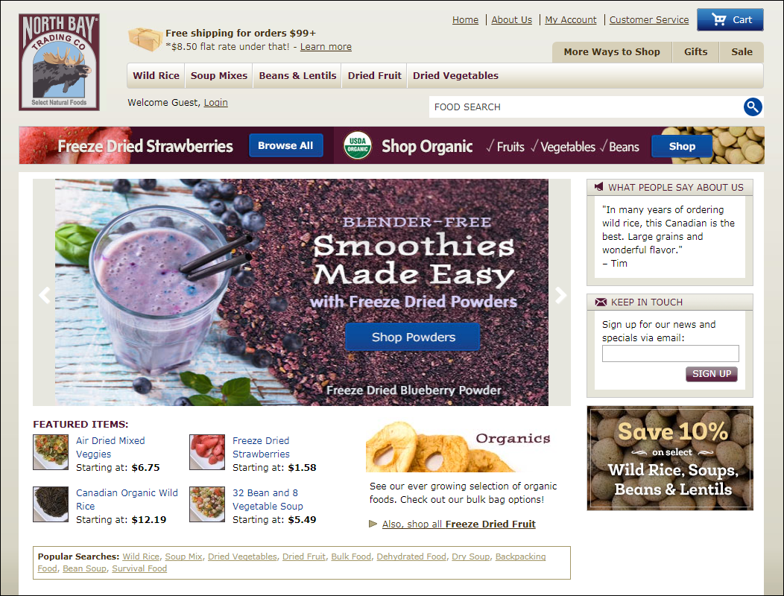
A website that is easy to use

Slide 5
What website users want
To find what they’re looking for as quickly and easily as possible
To get the information or do the task that they want to do as quickly and easily as possible

Slide 6
How website users use a web page
They scan the page to find what they’re looking for or a link to what they’re looking for.
They don’t like to scroll.
If they get frustrated, they leave.
They often click on links and buttons with the hope of finding what they’re looking for.
They frequently click on the Back button when they don’t find it.

Slide 7
Three guidelines for improving usability
Present all of the critical information “above the fold” so the user doesn’t have to scroll.
Group related items into separate components, and limit the number of components on each page.
Adhere to the current conventions for website usability.

Slide 8
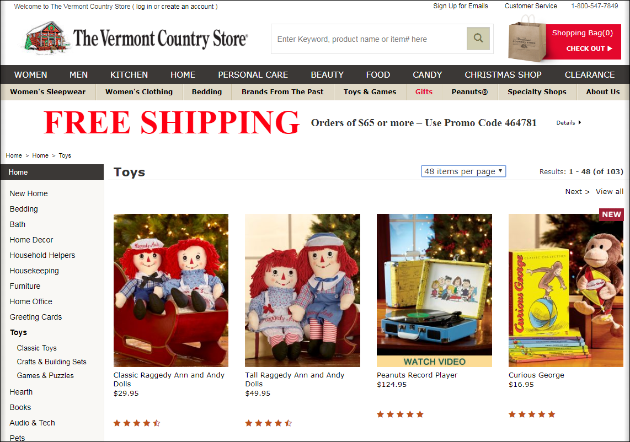
A web page that illustrates some of the current website conventions

Slide 9
Header conventions
The header consists of a logo, tag line, utilities, and a navigation bar.
The tag line identifies what’s unique about the website.
The navigation bar provides links that divide the site into sections.
The utilities consist of links to useful but not primary information.
If your site requires a search function, it should be in the header.
The search function should consist of a large text box for the entry followed by a search button.

Slide 10
Navigation conventions
Underlined text is always a link.
Images that are close to short text phrases are clickable.
Short text phrases in columns are clickable.
If you click on a cart symbol, you go to your shopping cart.
If you click on the logo in the header, you go to the home page.

Slide 11
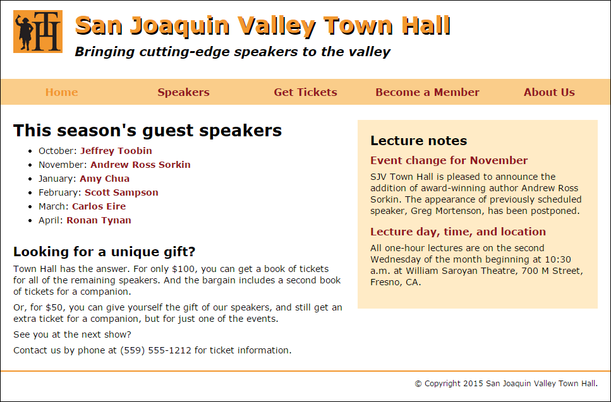
The full screen view of the Town Hall home page

Slide 12
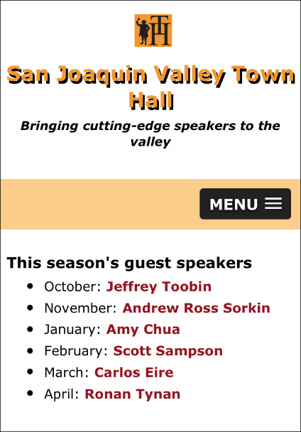
The mobile view of the Town Hall home page

Slide 13
Two ways to provide for mobile devices
Use Responsive Web Design
Build a separate website for mobile devices

Slide 14
Two ways to design the pages for Responsive Web Design
Mobile-first design
Design the mobile pages first. Then, expand those designs for larger browsers.
Desktop-first design
Design for computer browsers first, but make sure that the designs will work when the pages are displayed on mobile devices.

Slide 15
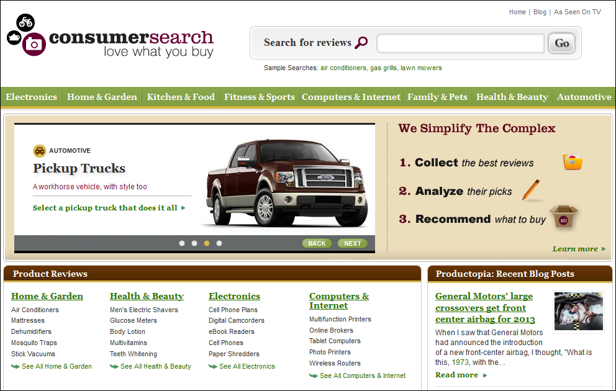
A home page that tries to sell the site

Slide 16
9 guidelines for developing an effective home page
Emphasize what your site offers that’s valuable and how your site differs from competing sites.
Emphasize the highest priority tasks of your site so users have a clear idea of what they can do.
Don’t welcome users to your site because that’s a waste of space.
Group items in the navigation areas so similar items are next to each other.
Only use icons for navigation if the users will readily recognize them.
Design the home page so it is different from the other pages of the site.
Don’t include an active link to the home page on the home page.

Slide 17
9 guidelines (continued)
Code the title element for the home page as the organization name, followed by a short description, and limit the title to 8 or fewer words and 64 or fewer characters.
If your site provides shopping, include a link to the shopping cart on your home page.

Slide 18
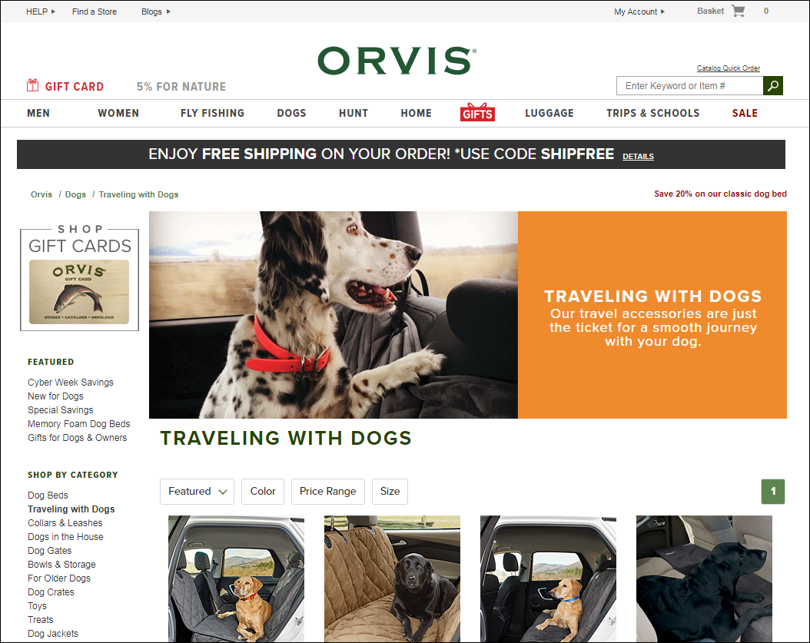
A page with breadcrumbs and highlighted links

Slide 19
How to let the users know where they are
Highlight the active links.
Make the heading for the page the same as the link that led to the page.
Provide breadcrumbs in this format:
Homepage > Dogs > Traveling with Dogs.

Slide 20
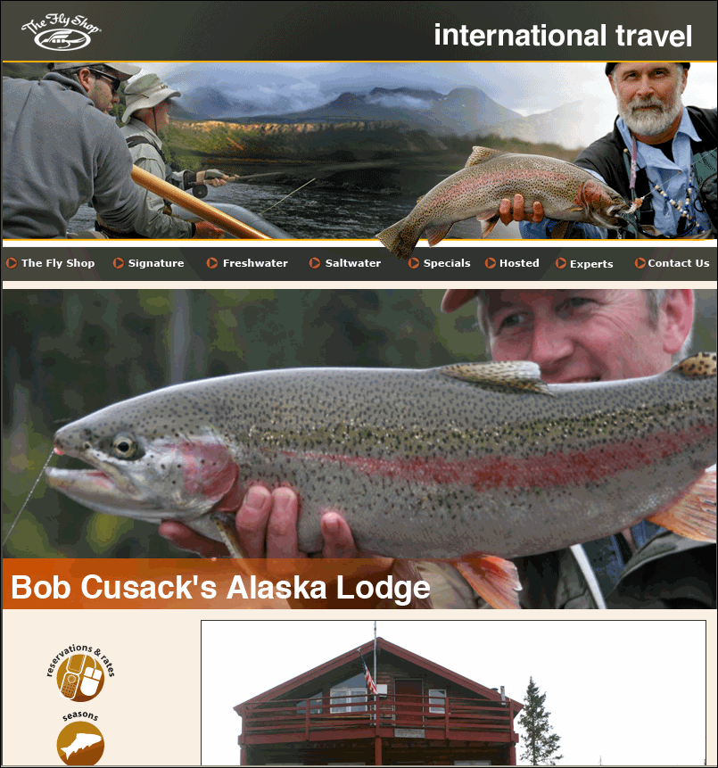
Wasted space on a primary page

Slide 21
Guidelines for the effective use of space
Keep the header relatively small.
Prioritize the components for each page.
Give the most important components the primary locations.

Slide 22
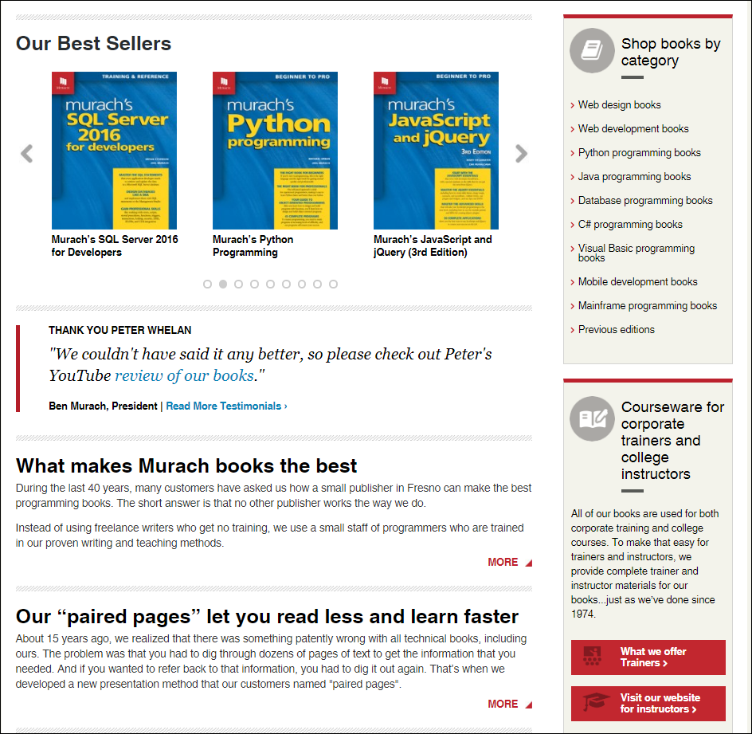
A home page that has been chunked

Slide 23
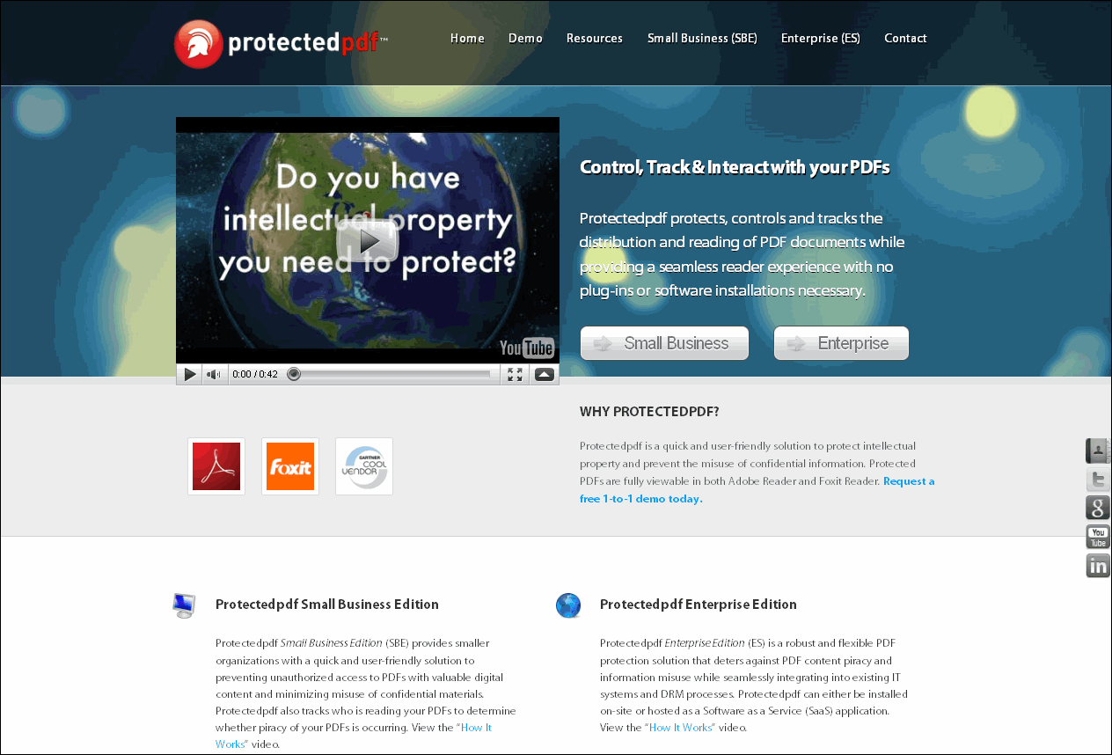
A page that ignores the basics of graphics design

Slide 24
Four principles of graphics design
Alignment means that related items on the page should line up with each other.
Proximity means that related items should be close together.
Repetition means that you should repeat some elements from page to page to give the pages continuity.
Contrast is what draws your eye to the components on a web page. If everything is the same, nothing stands out.

Slide 25
Typographical guidelines
Limit the line length of paragraphs to 65 characters.
Use a sans serif font in a size that’s large enough for easy reading.
Show the relationship between a heading and the text that follows by keeping them close.
Use dark text on a light background, and don’t use an image for the background.
Don’t center text and don’t justify text.
If you indent the first lines of paragraphs, you don’t need space between the paragraphs.
Don’t use reverse type (white type on a colored background) for text.

Slide 26
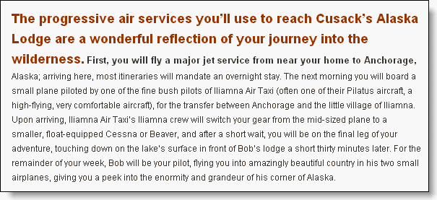
Writing that isn’t for the web (177 words and 1041 characters)

Slide 27
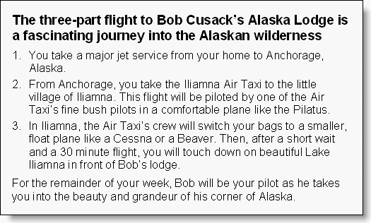
The same copy, but written for the web (135 words and 717 characters)

Slide 28
Web writing guidelines
Use fewer words.
Write in inverted pyramid style with the most important information first.
Use headings and subheadings to identify portions of the text.
Use bulleted lists and numbered lists to make information more accessible.
Use tables for tabular information.
Don’t use all caps (all capital letters) for headings. Usually, it’s best to capitalize only the first letter in a heading, plus any required capitalization.
Make the text for all links as explicit as possible.
Keep the line length to 65 characters or fewer.

Slide 29
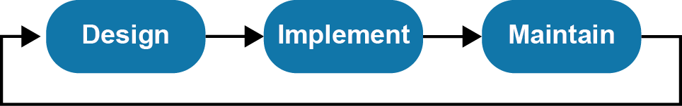
The lifecycle of a website

Slide 30
How to make a website easier to maintain
Use HTML for the content and CSS for the page layout and formatting.
Don’t use tables for page layout. Only use tables for tabular information.
Don’t use frames (not presented in this book).
Get the design right before you start implementing it.

Slide 31
A general procedure for designing a website
Define the audience and set the goals for the website.
Develop a site map.
Sketch or wireframe the critical pages in black and white.
Illustrate the critical pages in full color.

Slide 32
A general procedure for implementing a website
Develop the HTML and CSS templates for the pages.
Develop the web pages.
Deploy the site to a web server.
Test and launch the site.

Slide 33
A general procedure for maintaining a website
Plan the changes.
Design the changes.
Implement the changes.
Test and launch the changes.

Slide 34
About Town Hall
Town Hall is a community service that runs six lectures each year that are available to all of the members of the community.
The speakers for these lectures come from all over the country and are known experts in their fields.
After each lecture, a luncheon is held in the same building and the speaker for the day answers questions from the audience.
Eight days before each lecture, there’s a meeting at the local library to discuss the subject of the lecture.
Students are admitted to these lectures free.
Town Hall will soon be celebrating its 75th anniversary.

Slide 35
The target audience
Members of Town Hall
Prospective members of Town Hall
Donors and possible donors to Town Hall

Slide 36
The goals of the website
Provide all of the information that members need for attending the lectures.
Provide all of the information that non-members need for attending one or more lectures.
Convince non-members to become members.
List current donors and encourage people to become donors.

Slide 37
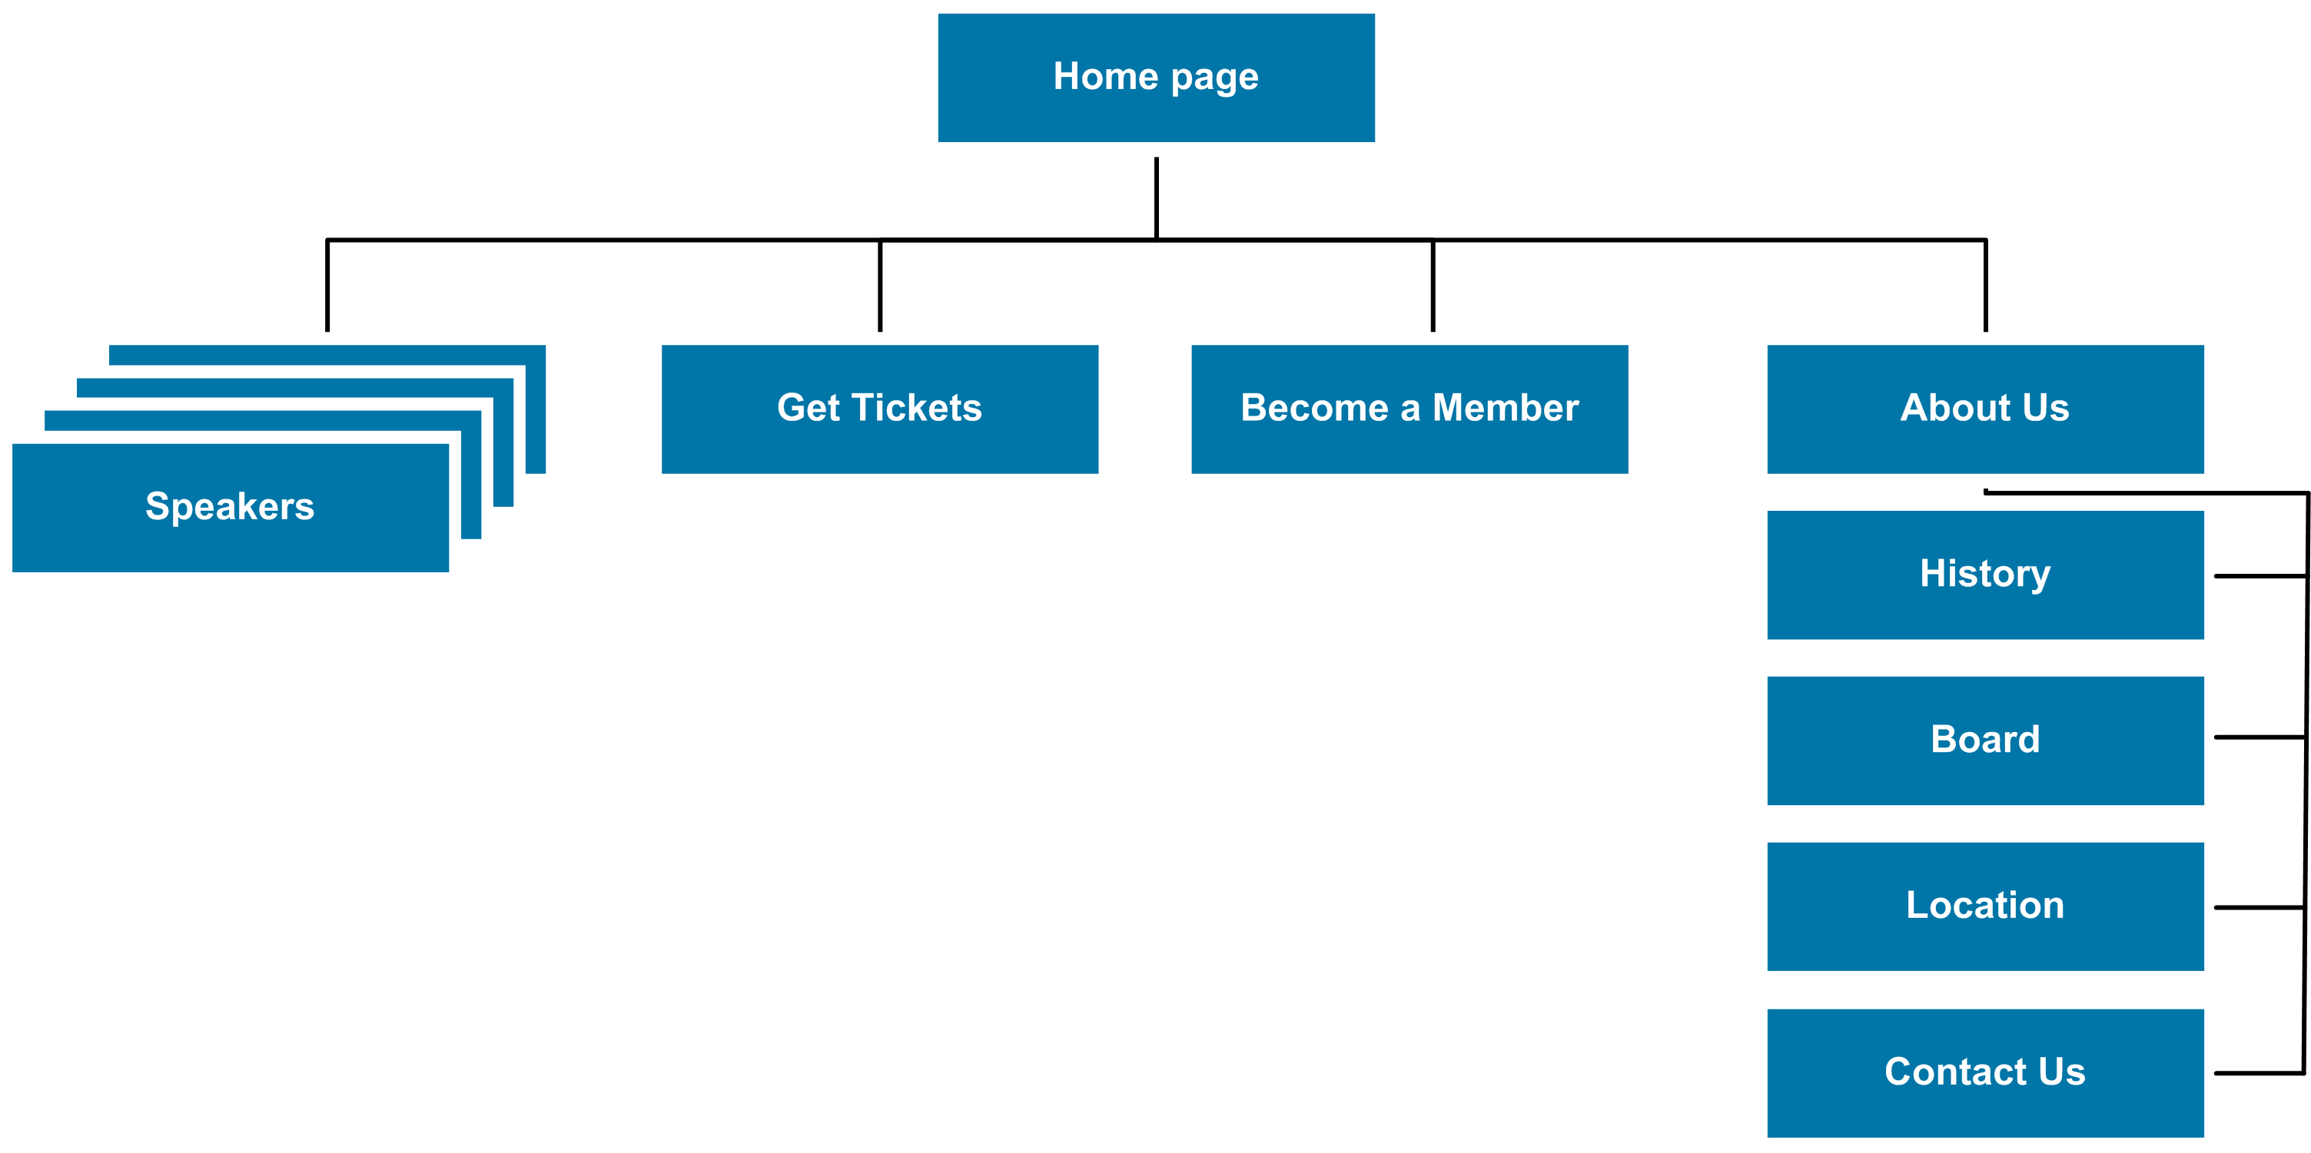
A site map for the Town Hall website

Slide 38
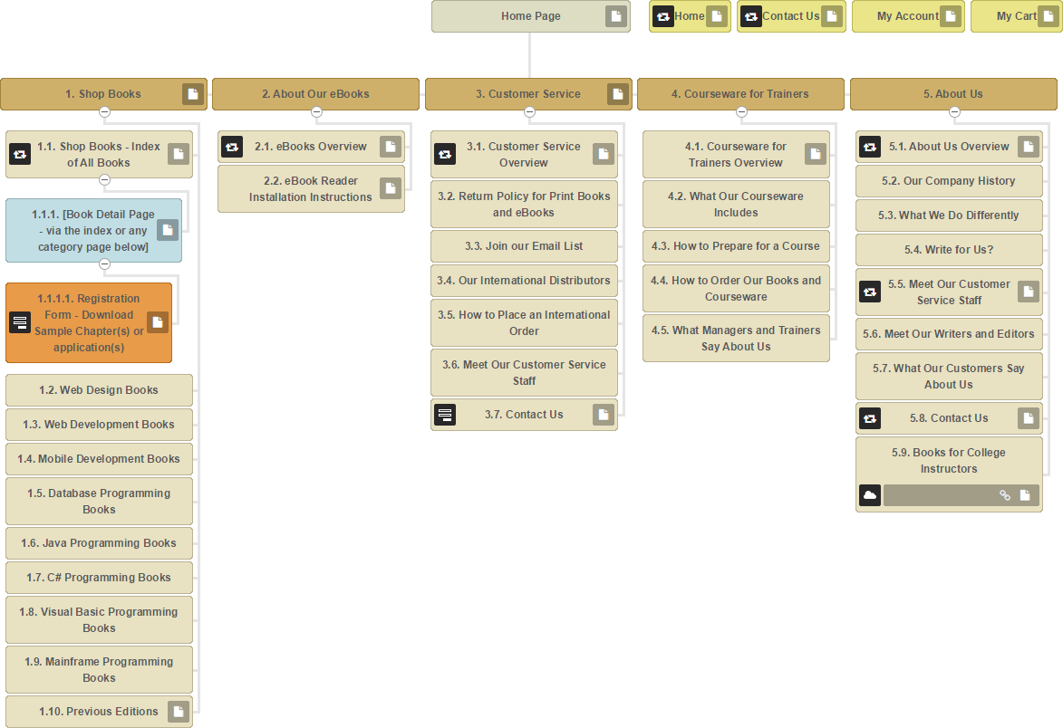
The site map for murach.com

Slide 39
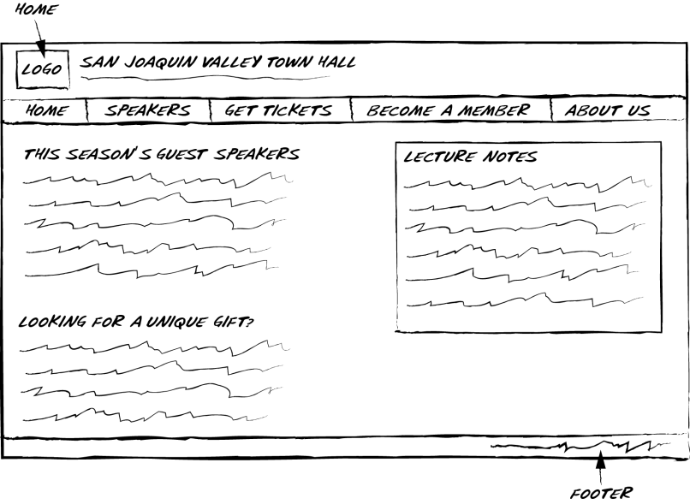
A sketch of the home page for Town Hall

Slide 40
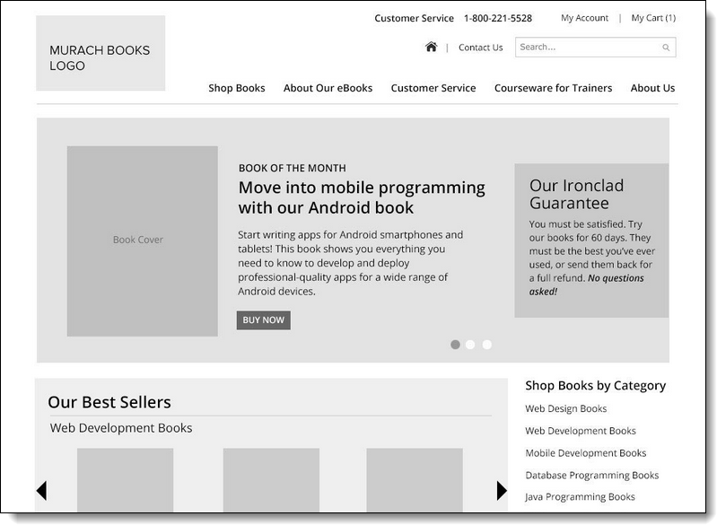
A wireframe for the home page of murach.com

Slide 41
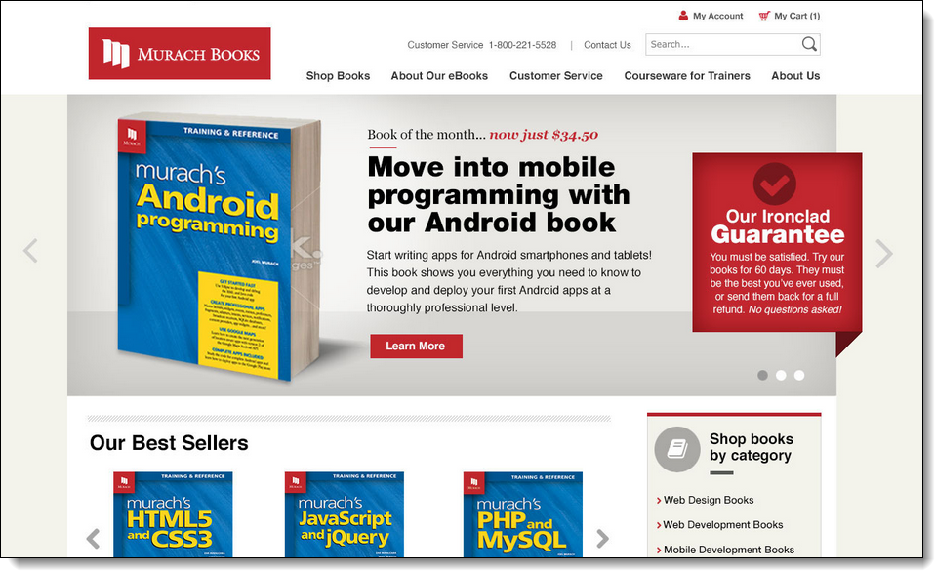
A Photoshop illustration for the home page

Slide 42
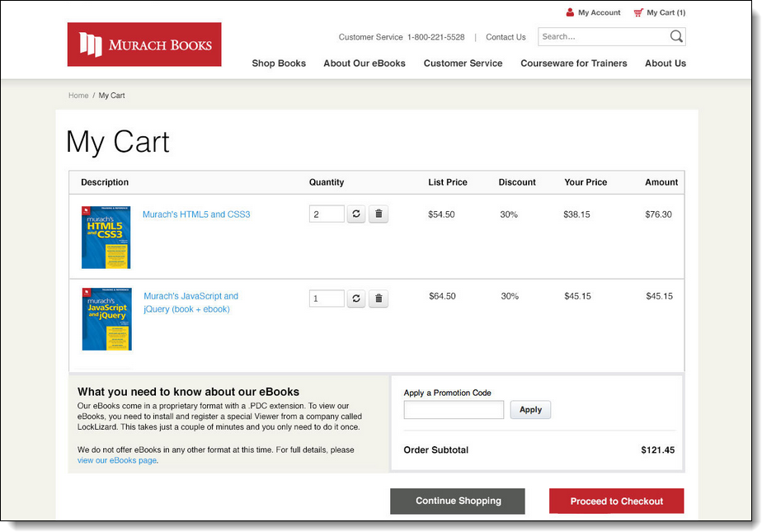
A Photoshop illustration for the Shopping Cart

Slide 43
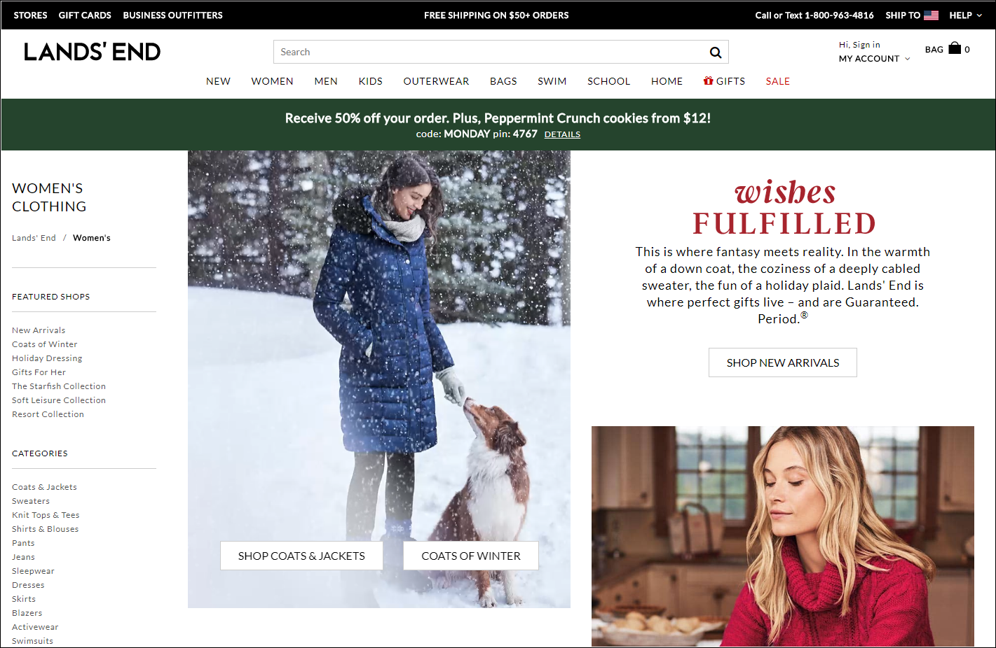
A large website that is managed by a team

Slide 44
Typical members of a development team
For design
Web designers
Writers
Marketing specialists
Graphics designers
For implementation
HTML and CSS specialists
Client-side programmers
Server-side programmers
Database administrator
Network administrator

Slide 45
Web designers vs. graphics designers
Web designers participate in all phases of web design.
Graphics designers focus on the graphics that make web pages work better and look more inviting.

Slide 46
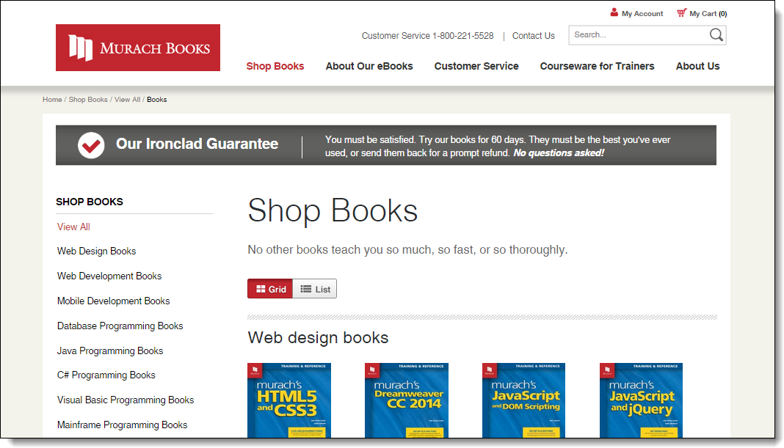
The prototype for the Shop Books page of murach.com

Slide 47
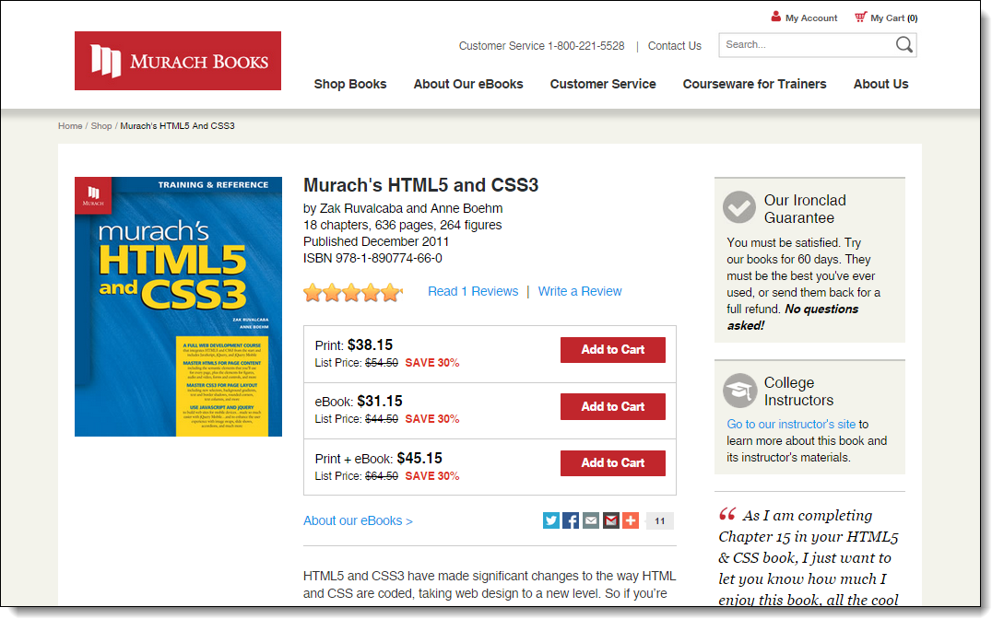
The prototype for one of the book pages

